Slide 1
Home Automation System using Arduino and Android App
CS225_CS226 Project
Shivam Sahu 1901CS55

Slide 2
Why this project?
We are living in the 21st century where automation of any form i.e. home or industrial plays an important role in human life. When it comes to industrial automation, the concept is applied to large machines or robots which helps in increasing the efficiency in terms of production, energy and time.
Home automation on the other hand involves automating the household environment. This is possible because of the smartphones and internet that we are widely using. Home automation can be again divided into just controlling the appliances using a smartphone from a remote location and another type filled with sensors and actuators which controls the lighting, temperature, door locks, electronic gadgets, electrical appliances etc. using a “Smart” system.
In this project, we will design a simple home automation project using simple components using which different electrical appliances can switched on or off. The project is based on Arduino and we have used Arduino UNO for the project.

Slide 3
Components Required
Arduino UNO with USB Cable
Bluetooth Module HC-05
4-Channel Relay Module
Jumper Wires
Smartphone or Tablet (Bluetooth Enabled)
Bulb
Power Source

Slide 4
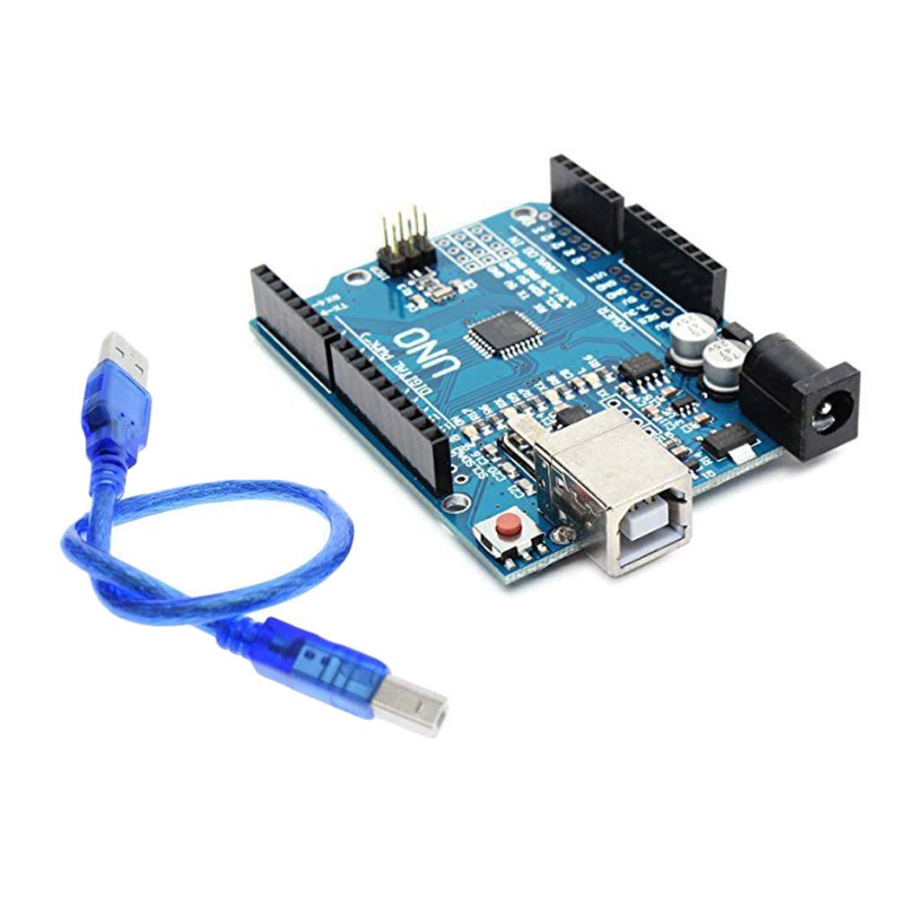
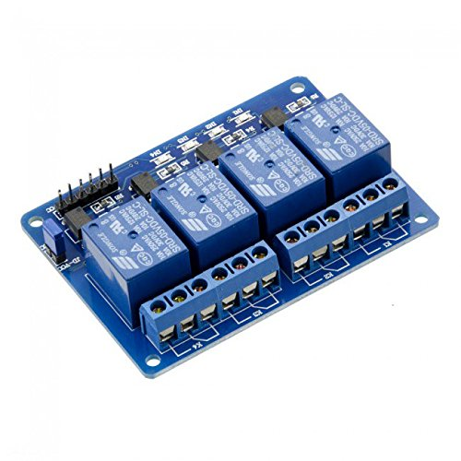
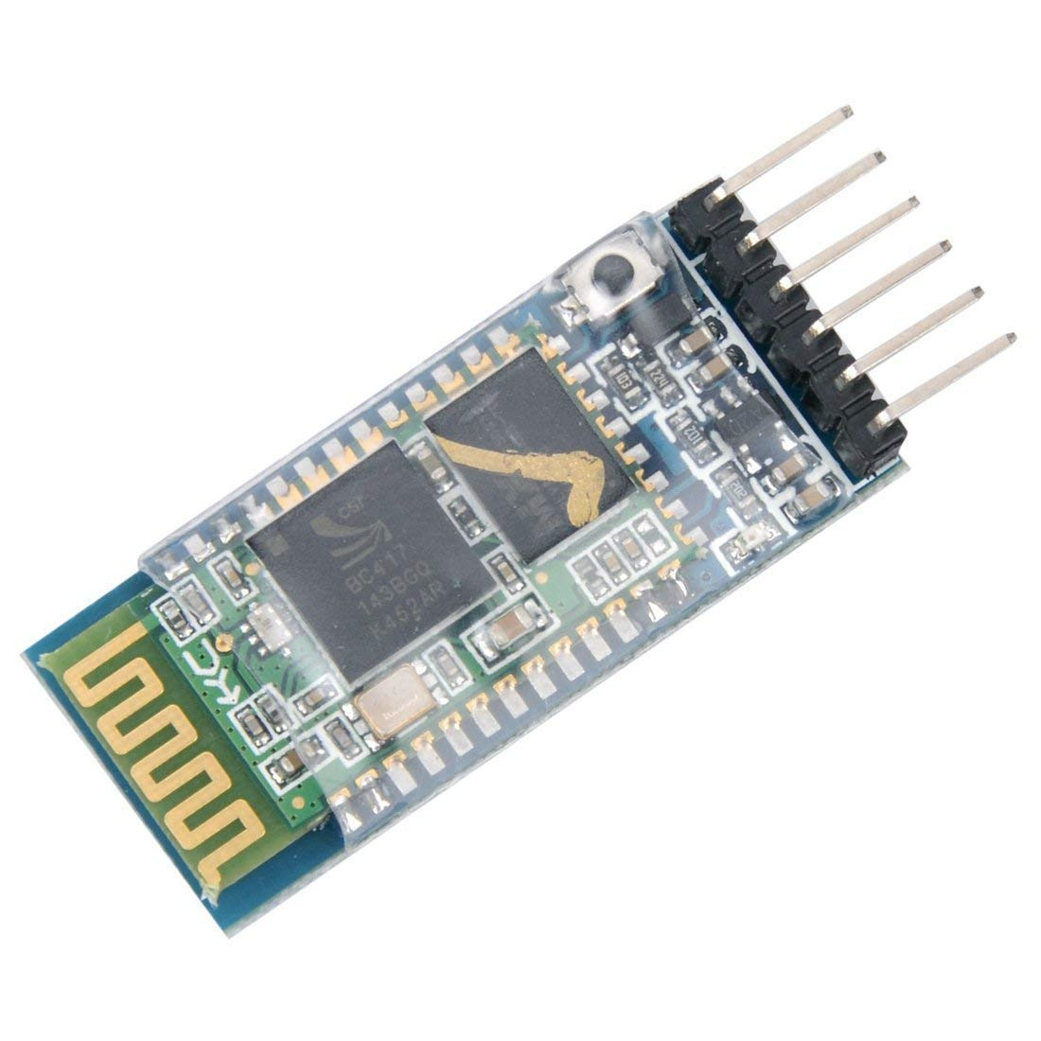
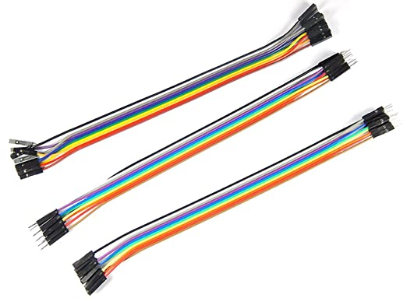
‘
3. 4-Channel Relay Module
1. Arduino UNO with USB Cable
4. Jumper Wires
2. Bluetooth Module HC-05

Slide 5
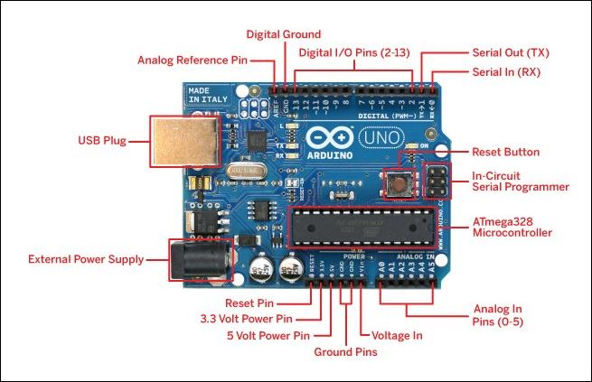
Hardware Specification of Arduino UNO

Slide 6
1. Arduino UNO
The 8 – bit ATmega 328P microcontroller based Arduino UNO is used in the project to control different components like Bluetooth module and relay network. It takes the power from the USB Cable through Laptop.
2. Bluetooth Module HC-05
The Bluetooth Module used in this project is HC- 05. As seen in the image below, this Bluetooth module has 4 – pins for VCC (5V), ground, TX and RX. This Bluetooth can be used with Bluetooth enabled phone (or tablet or laptop) and the range of this module is approximately 10 meters.
3. 4-Channel Relay Module
A 4 – channel relay board is used in this project to control four different loads. It has all the necessary components and connections like base current limiting resistor, flyback diode, LED indicators and header for connecting it to other devices.

Slide 7
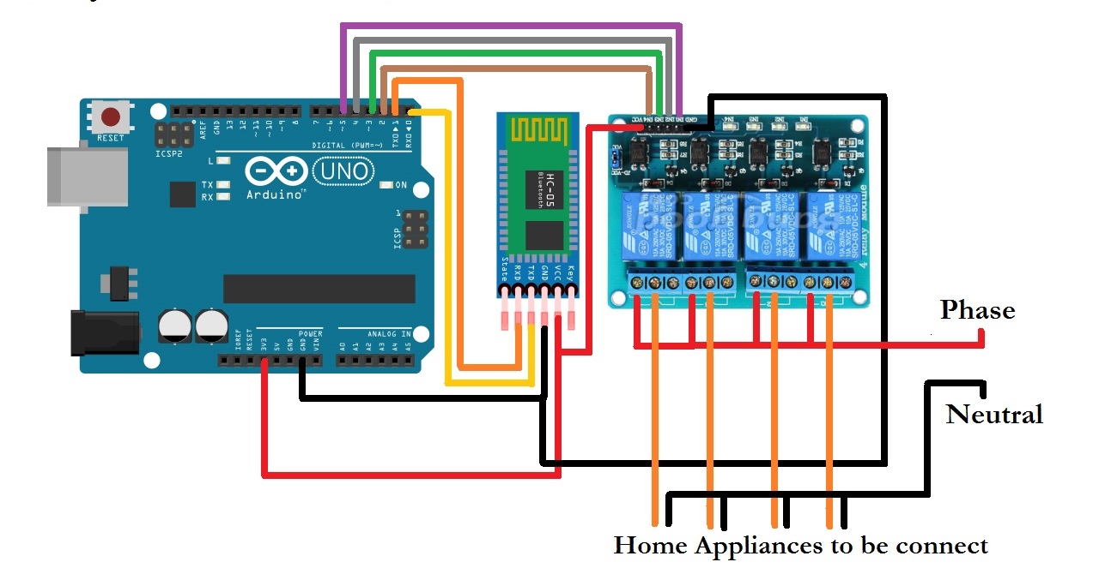
Circuit Diagram

Slide 8
Circuit Design
The circuit design of Home Automation based on Arduino and Bluetooth is very simple and is explained below.
The Bluetooth module has 4 – pins: VCC, TX, RX and GND. VCC and GND are connected to 5V and ground from Arduino UNO respectively.Bluetooth module works on 5V.
The TX and RX pins of the Bluetooth module must be connected to RX and TX pins of the Arduino.But when connecting RX of Bluetooth to TX of Arduino (or any microcontroller as a matter of fact), we need to be careful as the pin can tolerate only 3.3V. But the voltage from TX or Arduino will be 5V.
The next step is to connect the digital I/O pins of the Arduino to input of the relay board.Normally Closed (NC) terminal is connect to the Bulb and Common (COMM) terminal is connected with the power source.
We are powering the Arduino UNO with the help of laptop through the USB Cable.

Slide 9
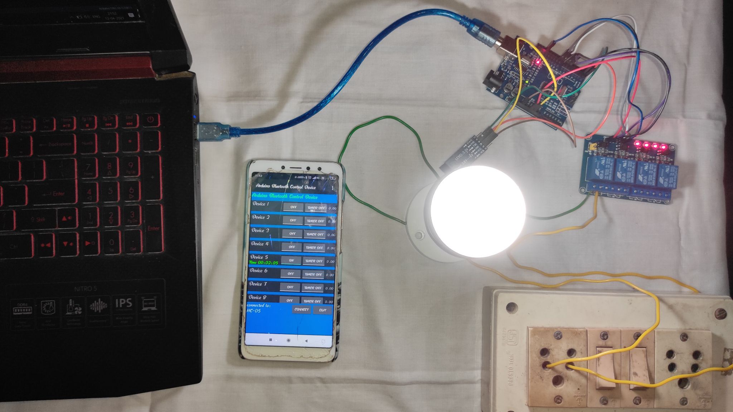
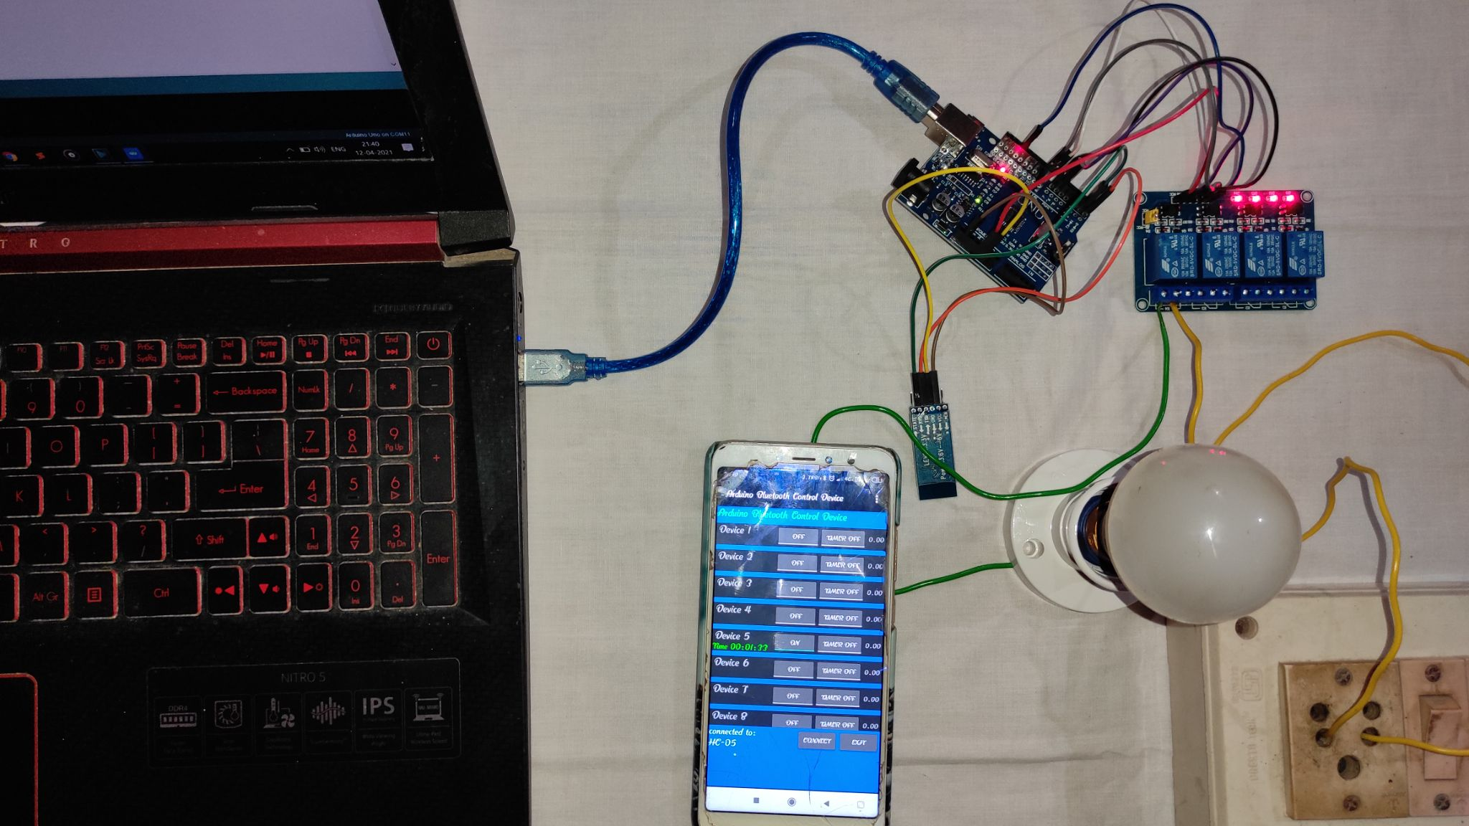
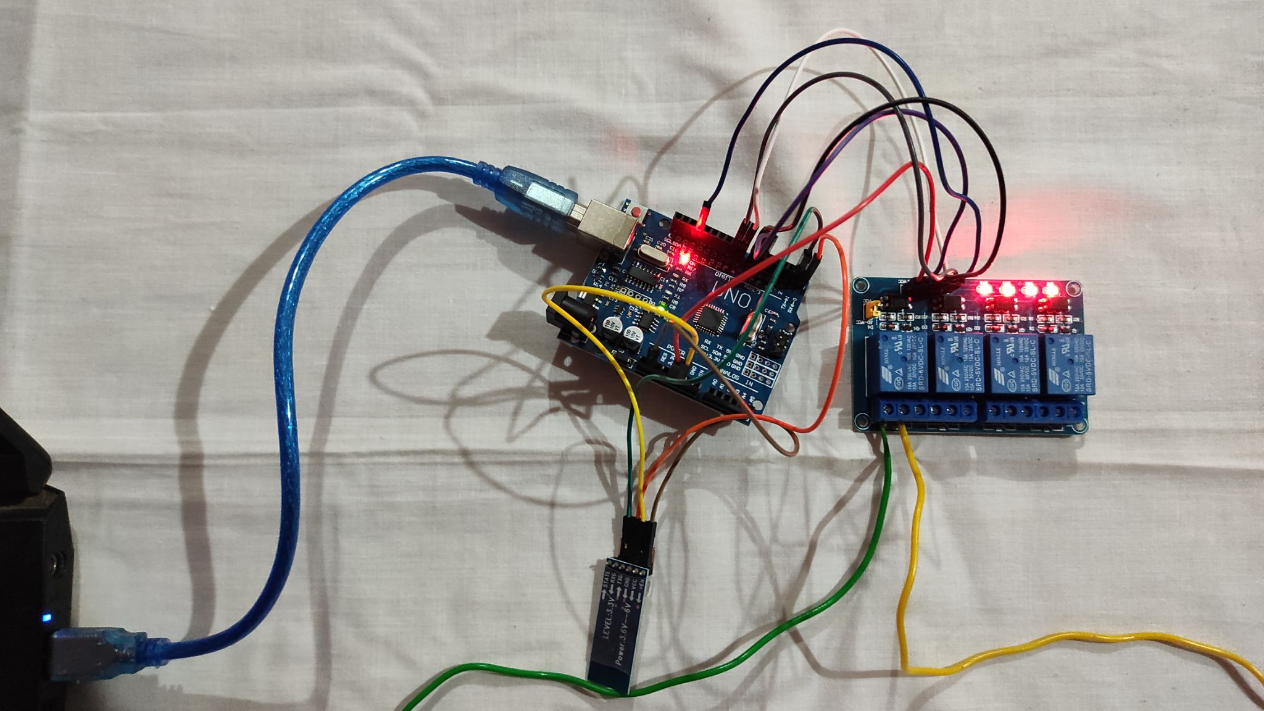
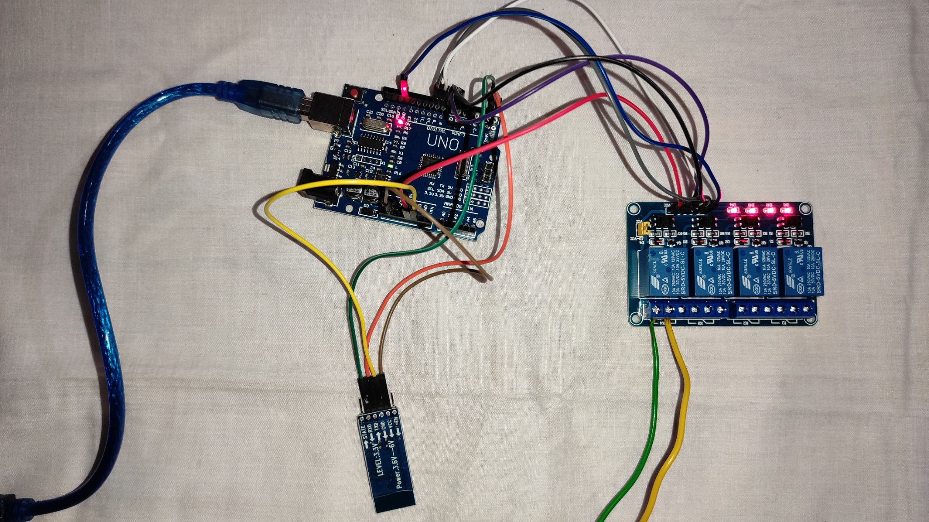
Project Images

Slide 10
Working Process
A simple home automation project using Arduino UNO, Bluetooth module and a smartphone. The aim of this project is to control different home appliances ( a Bulb in our project ) using a smartphone. The working of the project is explained here.
The required code is uploaded in the Arduino UNO using the Arduino IDE.
When the power is turned on, the connection LED on the Bluetooth module starts blinking. We need to start the “Arduino Bluetooth Control Device” app in our smartphone and get connected to the Bluetooth module. If the pairing is successful, the LED becomes stable.
Now, in the app, we can control at most 8 devices at a time. The load ( i.e Bulb in our project ) is set to device 5 by default.Then we are ready to control the loads.When a key is pressed in the smartphone, the Bluetooth module receives the corresponding data and intern transmits that data to Arduino.
For Example: When we press ‘ON’ against device 5 in the app, the data received by the Bluetooth module is ‘5’ and ‘ON’.This data is transmitted to Arduino. Arduino then compares the received data with the data written in the sketch and accordingly turns on the device 5. The similar action can be applicable to other keys and loads.
Using this type of connection, we can control i.e. turn on or off different home electrical appliances using our smartphones.

Slide 11
Applications and Future Aspects
Using this project, we can turn on or off appliances remotely i.e. using a phone or tablet.
The project can be further expanded to a smart home automation system by including some sensors like light sensors, temperature sensors, safety sensors etc. and automatically adjust different parameters like room lighting, air conditioning (room temperature), door locks etc. and transmit the information to our phone.
Additionally, we can connect to internet and control the home from remote location over internet and also monitor the safety

Slide 12
Limitations
The system needs a continuous power supply to be practical or else we might not be able to control the appliances.
Hence, best way to design the system efficiently would be to implement both the automated control and manual control through switches at a time.

Slide 13

References
https://www.arduino.cc/en/main/documentation
https://randomnerdtutorials.com/guide-for-relay-module-with-arduino
https://bulebots.readthedocs.io/en/latest/hc05_bluetooth.html
https://www.instructables.com/
https://www.security.org/home-automation/

Slide 14
It was an insightful undergoing working on such discerning project.
Thankyou !!!

